Slide 1
Accessibility in design of learning resources
Adam Warren
Institute for Learning Innovation and Development
Jane Warren
Southampton Education School
Notes:
Who are we?
Iliad
ADSHE
Apology for not modelling good practice ;-) but will record.

Slide 2
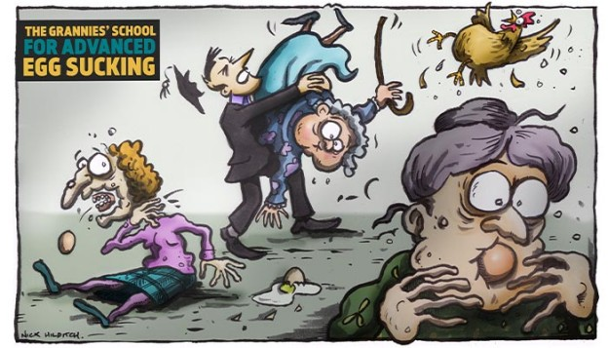
Image: http://www.itsagloriousday.co.uk/grannies-school-for-advanced-egg-sucking/

Slide 3
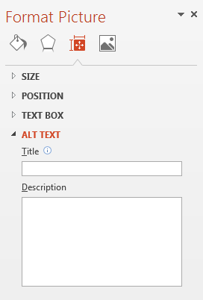
Adding ALT text to images
Right click on image
Choose Format Picture
Size & Properties
Fill in Description + Title if long description
How much description?
Quick Access Toolbar
Notes:
Visual impairment and screen readers

Slide 4
What do you think are three key actions to improve accessibility?
Notes:
5 minute discussion

Slide 5

Institutional context
The Equality Act 2010
The Disabled Students’ Allowances (DSA)
Institutional obligations and duties
Disabilities and specific learning difficulties
International students (EAL)
Notes:
Equality act
DDA/senda from 2001
Protected characteristics
Not less favourable
Points - historically HEIs have to an extent relied on DSAs and demand has spiralled in line with wid part. In 2014 Willetts announced reforms to DSA and an increased emphasis on HEIs meeting the DED firm their own resource. Dyslexia particularly targeted as by far the most common reported disability according to HESA. While this is largely a cost-cutting exercise the sentiment is reasonable. In the field we suspect no DSA support for standard dyslexia by 2018. This means that HEIs will need to do more to meet the anticipatory duty and move to inclusive practices. Here, Panopto, Synote, group tutorials are all being emphasised. To what extent does institutional tech replace 1:1 or student-following solutions? How much institutional shift in thinking will be needed?

Slide 6
Making documents readable
Signposting and scanning
Structure and space
Headings (Styles)
bullet lists
Formatting
bold instead of underline
avoid ALL CAPS
Charts, diagrams and graphs
ALT text
Notes:
How do you read journal articles?
Poor example reformatted to make it better

Slide 7

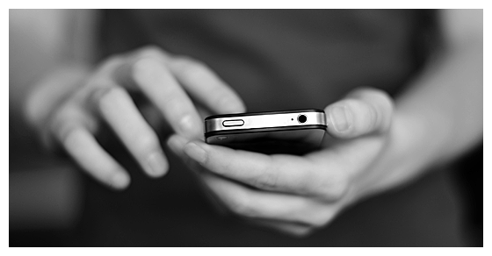
File formats
Word, PPT, PDF
Apple (or Linux) friendly?
Mobile (iOS and Android) friendly?
Notes:
Example of Word to accessible PDF – show text to speech in Adobe Reader
6 slides to a sheet? – let the student have control
Demo of mobile reading and annotation

Slide 8
The right type?
Times New Roman
Serif
Palatino
Georgia
Arial
Sans Serif
Verdana
Calibri
Comic Sans
Display
Papyrus
Viner Hand
Notes:
For the right purpose.

Slide 9
The right type?
I quickly explained that many big jobs involve few hazards. 1234567890
I quickly explained that many big jobs involve few hazards. 1234567890
I quickly explained that many big jobs involve few hazards. 1234567890
I quickly explained that many big jobs involve few hazards. 1234567890
I quickly explained that many big jobs involve few hazards. 1234
I quickly explained that many big jobs involve few hazards. 1234567890
I quickly explained that many big jobs involve few hazards. 1234567890
I quickly explained that many big jobs involve few hazards. 1234567890
I quickly explained that many big jobs involve few hazards. 1234567890
Notes:
Not the whole story. Very much personal preference. Cautionary tale.
Ebook readers.

Slide 10
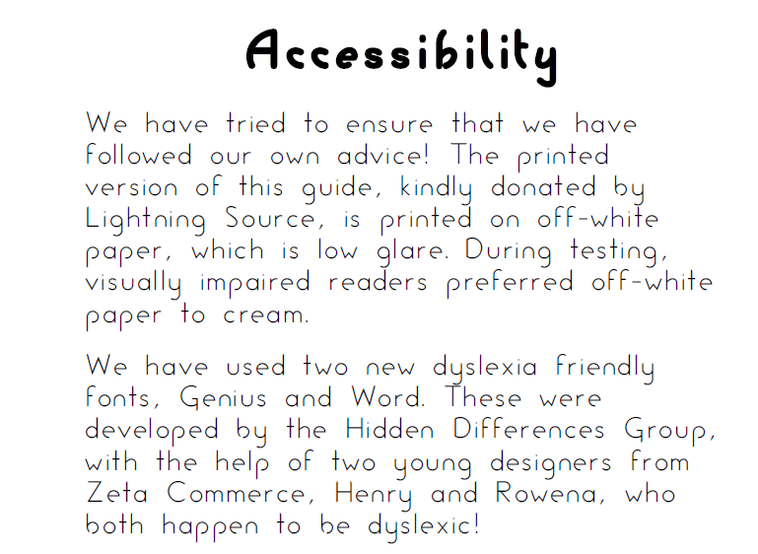
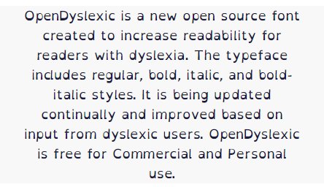
How (not) to do it
The Great Communication Guide (2006)
Open Dyslexic
Notes:
Dyslexia-friendly fonts – people always ask – definitely go beyond ‘what’s good for dyslexia is good for everybody’. This initiative, happily, didn’t last long but shamefully was endorsed by the BDA, the RNIB and others who should have known better, and a version was used in the influential 2009 Rose Report into dyslexia – making sure that it displays appallingly on any screen as the PDF converter does not ‘get’ this non-standard font.
Open Dyslexic is good to be aware of – in the interests of keeping the user in control – but should never be adopted for general use. Throw out 500 years of typographical understanding at our peril. Personal choice.

Slide 11

Recommendations
Font: Sans Serif (or Serif)
Body text: at least 11 point
Align left, ragged right margin
Line spacing: 2 points
Paragraph spacing: 6 points
Page margins: at least 20mm

Slide 12
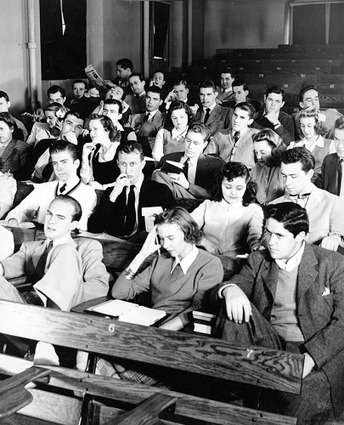
Lectures
CC Image: Duke University 1940s

Slide 13
Lectures
Slides and lecture notes
Visual aids
Structure and space
Colours and contrast
Accessible templates: http://www.edshare.soton.ac.uk/3081/
Thinking time
Students with hearing impairments
Notes:
Show a couple of templates

Slide 14
Lectures
Slides and lecture notes
Visual aids
Structure and space
Colours and contrast
Accessible templates: http://www.edshare.soton.ac.uk/3081/
Thinking time
Students with hearing impairments
Notes:
Show a couple of templates

Slide 15
Timing
In advance
Overviews?
Skeleton notes?
Impact on attendance?
Notes:
Discussion 5 mins

Slide 16
Lecture capture
Students recording lectures
Student demand
Pros and cons
When is it the answer?
Policies
1400 student responses
Did students want all of their lectures to be recorded?
YES = 95% of students
97% of international students
Notes:
Pros
Review and revise content
Re-watch points of difficulty
Take notes at own pace
Allows students to focus more on the teaching
Catch up on missed sessions (illness, disability, mental health)
Cons
Impact on attendance?
Works best with didactic content
Affect in-class discussion – BEST PRACTICE
Problems of confidentiality - esp in health professions or ITE contexts.

Slide 17

What is possible?
Screen + audio
Video: lecturer, whiteboard, webcam
Upload video file (e.g. from phone)
Simple editing
Viewers:
Navigation
Speed control
Transcript (Synote)

Slide 18
Assistive technologies
AT bar – a quick demo
Other student-facing tools:
Dragon Naturally Speaking (speech > text)
ClaroRead (text > speech)
Mind-mapping tools
Online dictionary
Adobe Reader (text > speech)

Slide 19
What three actions will you take to improve accessibility?

Slide 20
Further reading/links
JISC initiatives
https://www.jisc.ac.uk/guides/getting-started-with-accessibility-and-inclusion
https://elevator.jisc.ac.uk/e/accessiblebydesign
http://www.lexdis.org.uk/

