Slide 1
Topics in socio-technical systems
@COMP6037
Elena Simperl
04 December 2014
Notes:
Please use the dd month yyyy format for the date for example 11 January 2008. The main title can be one or two lines long.

Slide 2
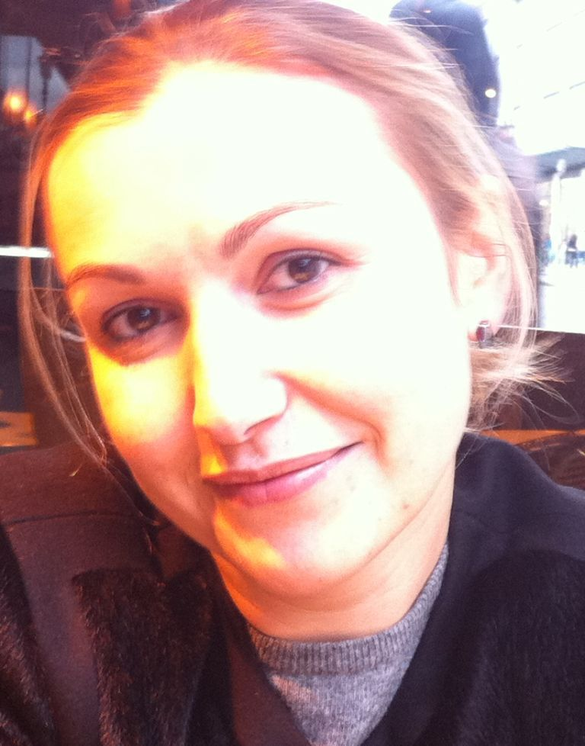
About me
PhD in Computer Science FU Berlin, Germany (2007)
Worked for FU Berlin, Germany; STI Innsbruck, Austria; KIT, Germany
Associate professor, Web and Internet Science group (since 11/2012)
Research interests
  Social computing
  Crowdsourcing
  Collaborative technologies
  Semantic technologies and Linked Data management
  Open data
  (Non-technical challenges of) data science
  User-centered design
e.simperl@soton.ac.uk

Slide 3
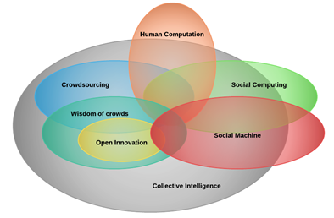
Socio-technical systems
Systems bringing together human/social and machine capabilities, empowered by the Web (2.0)

Slide 4




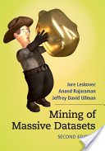
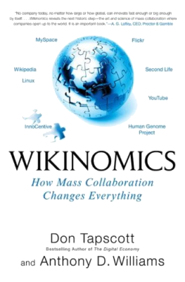

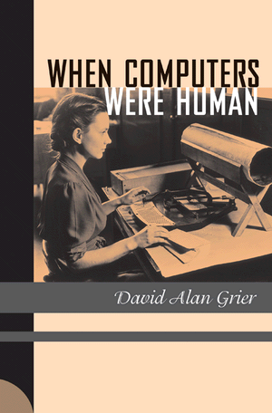
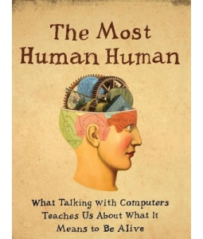
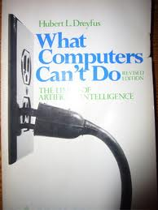
Main areas and their challenges

Slide 5
Example: theoretical frameworks
Map out the design space and define guidelines and best practices

Slide 6
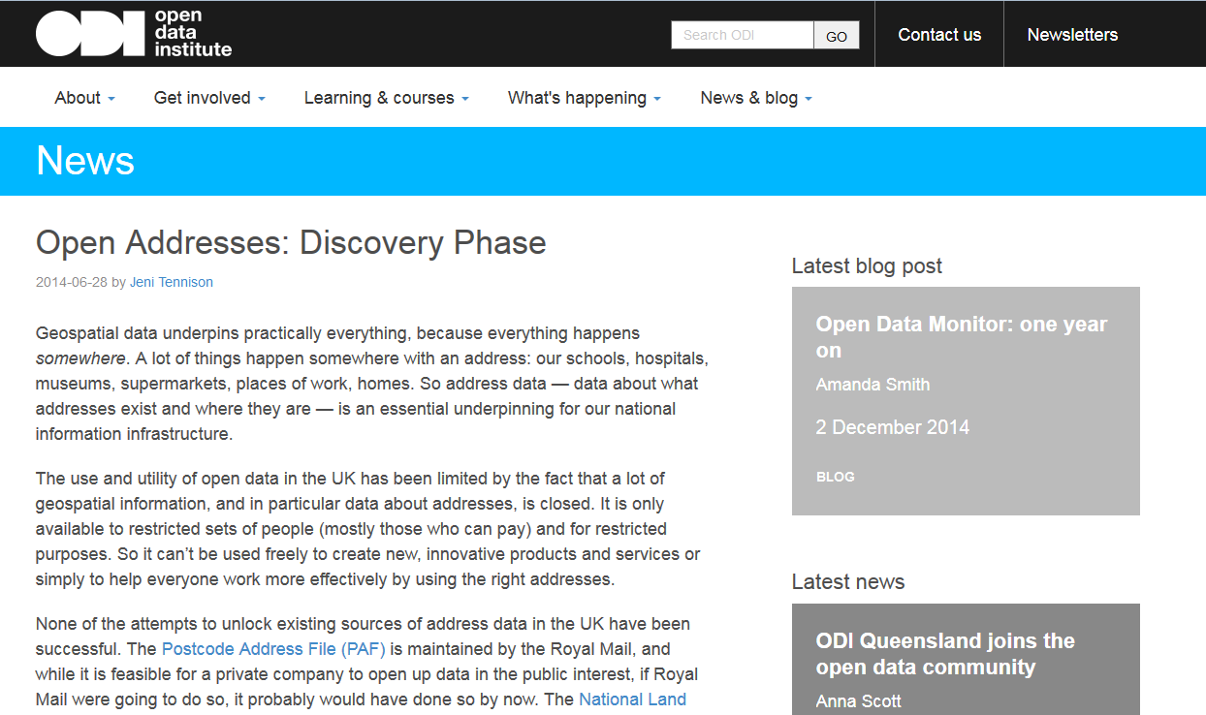
Example: Open Addresses
Building a socio-technical ecosystem to (re-)create a digital artifact

Slide 7
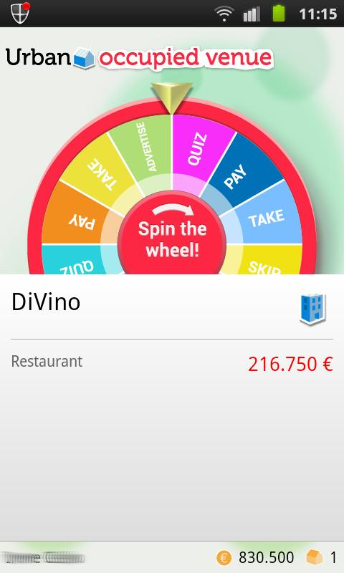
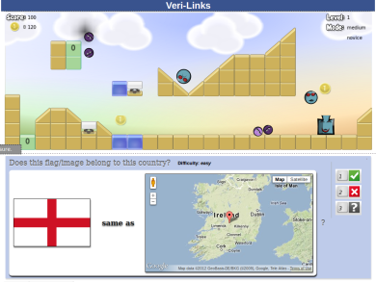
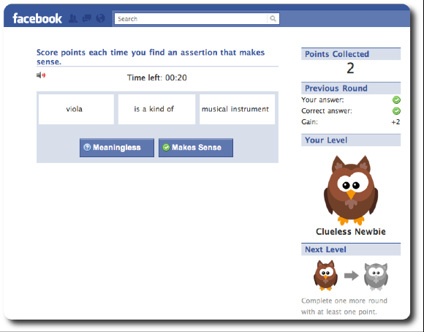
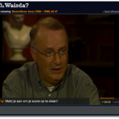
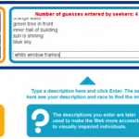
Example: Games with a purpose (GWAP)
See also [van Ahn & Dabbish, 2008]
Designing a game narrative for a technical problem that computers aren’t (yet) good at.

Slide 8
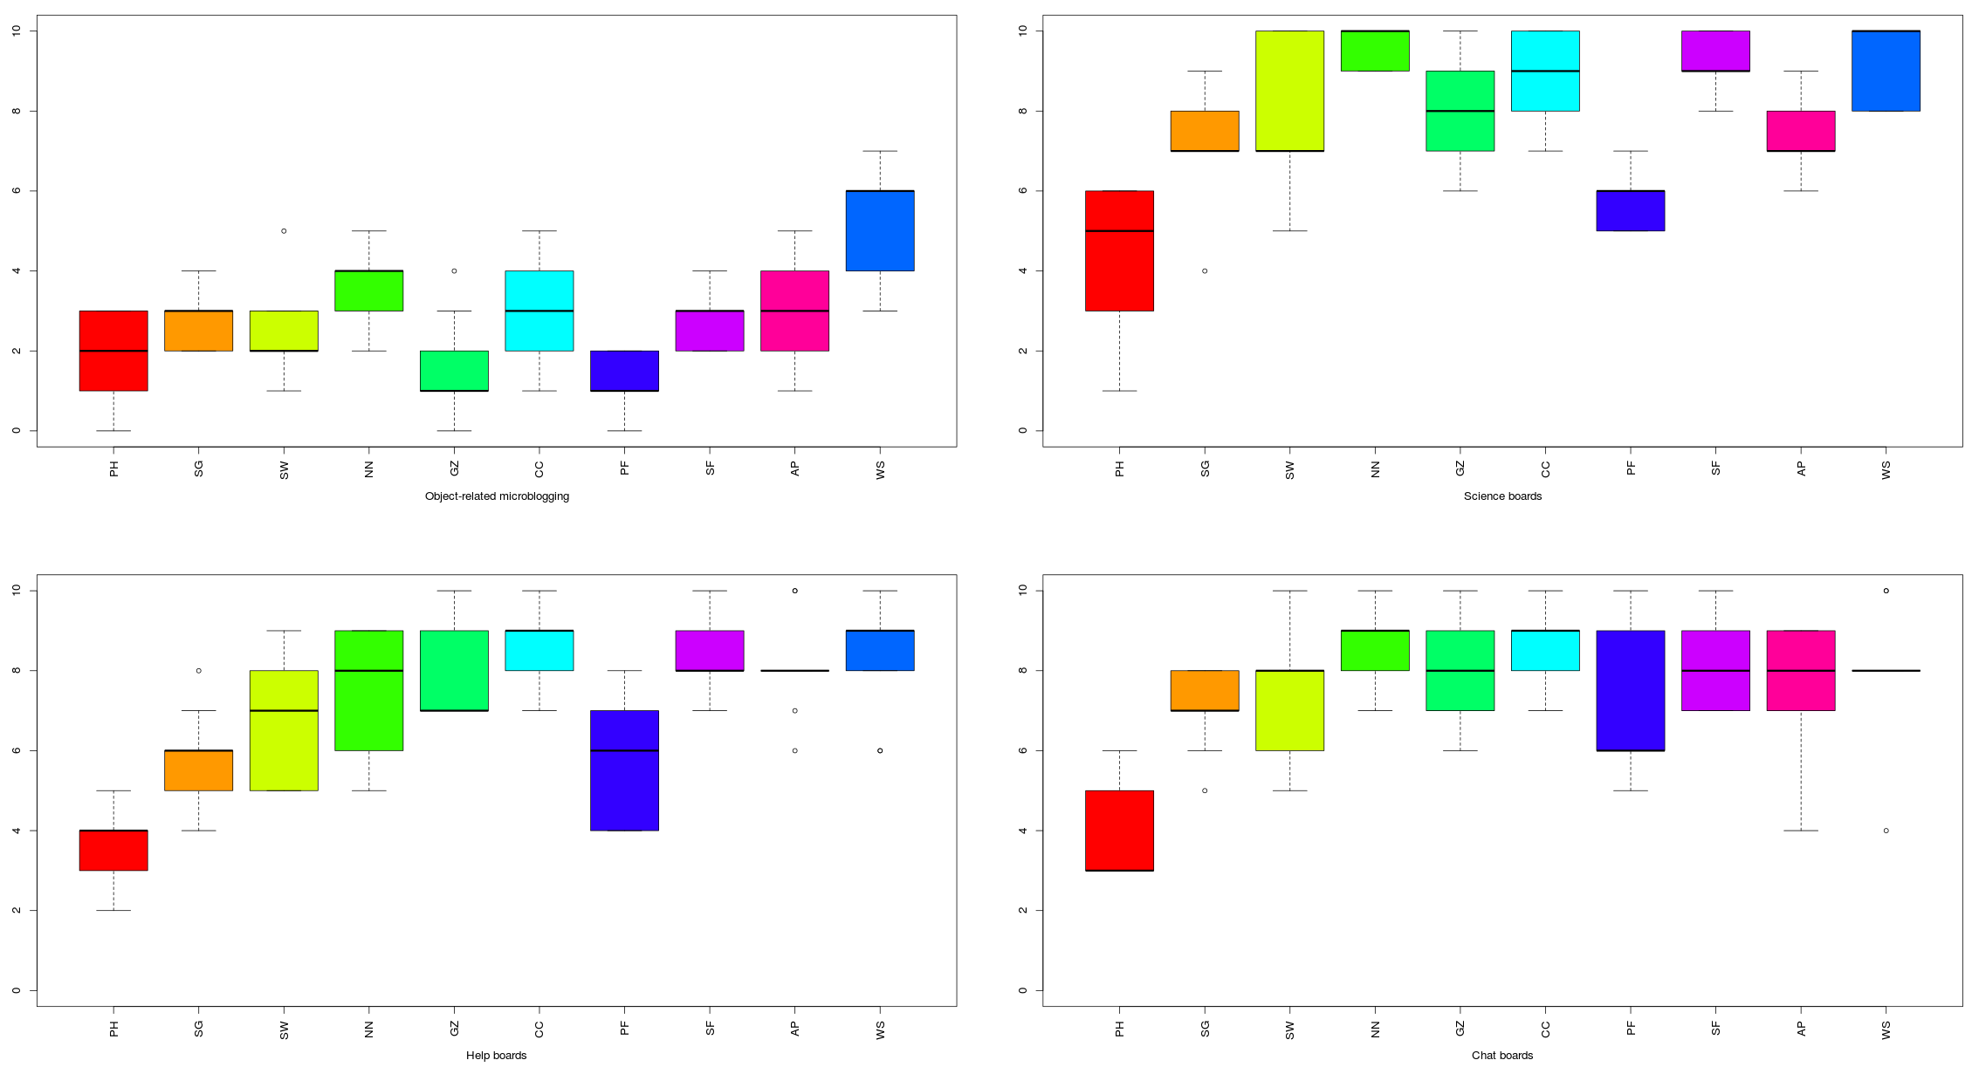
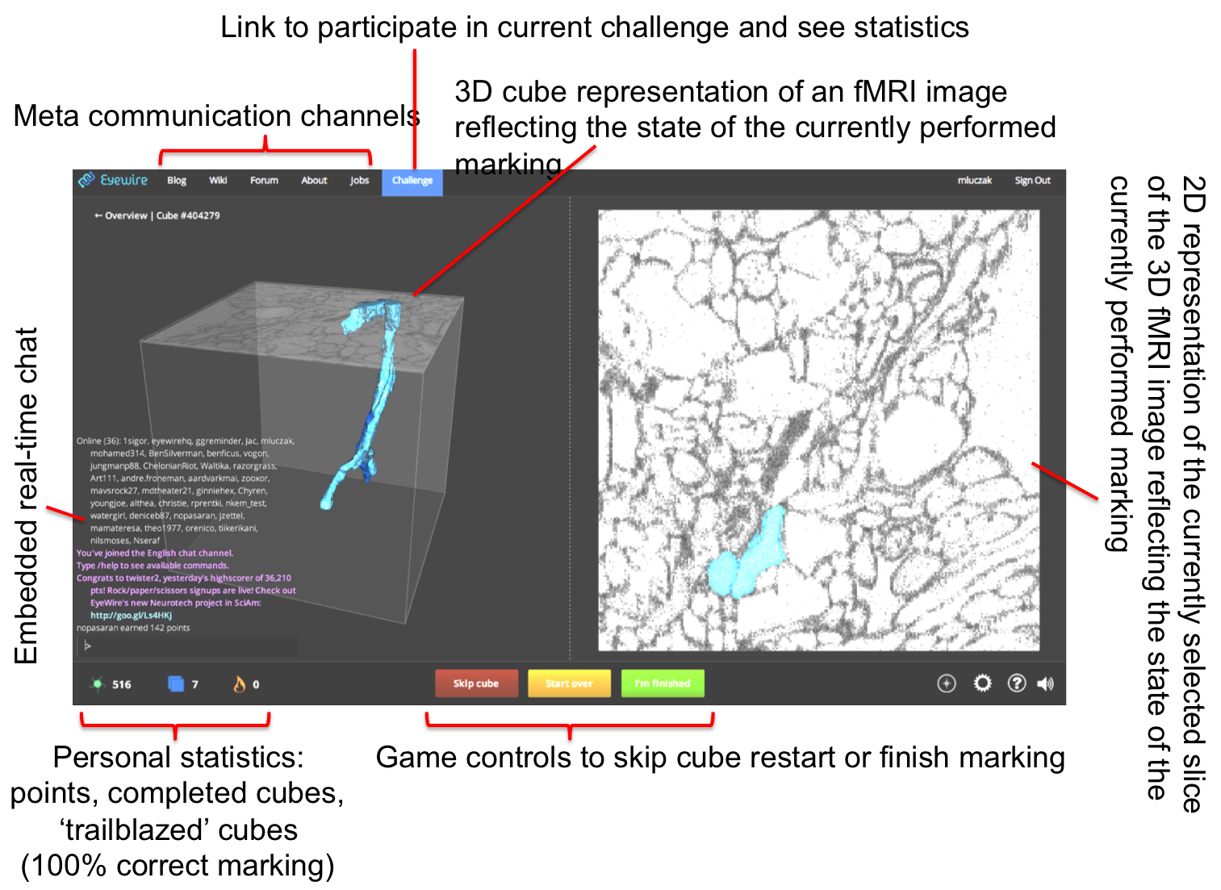
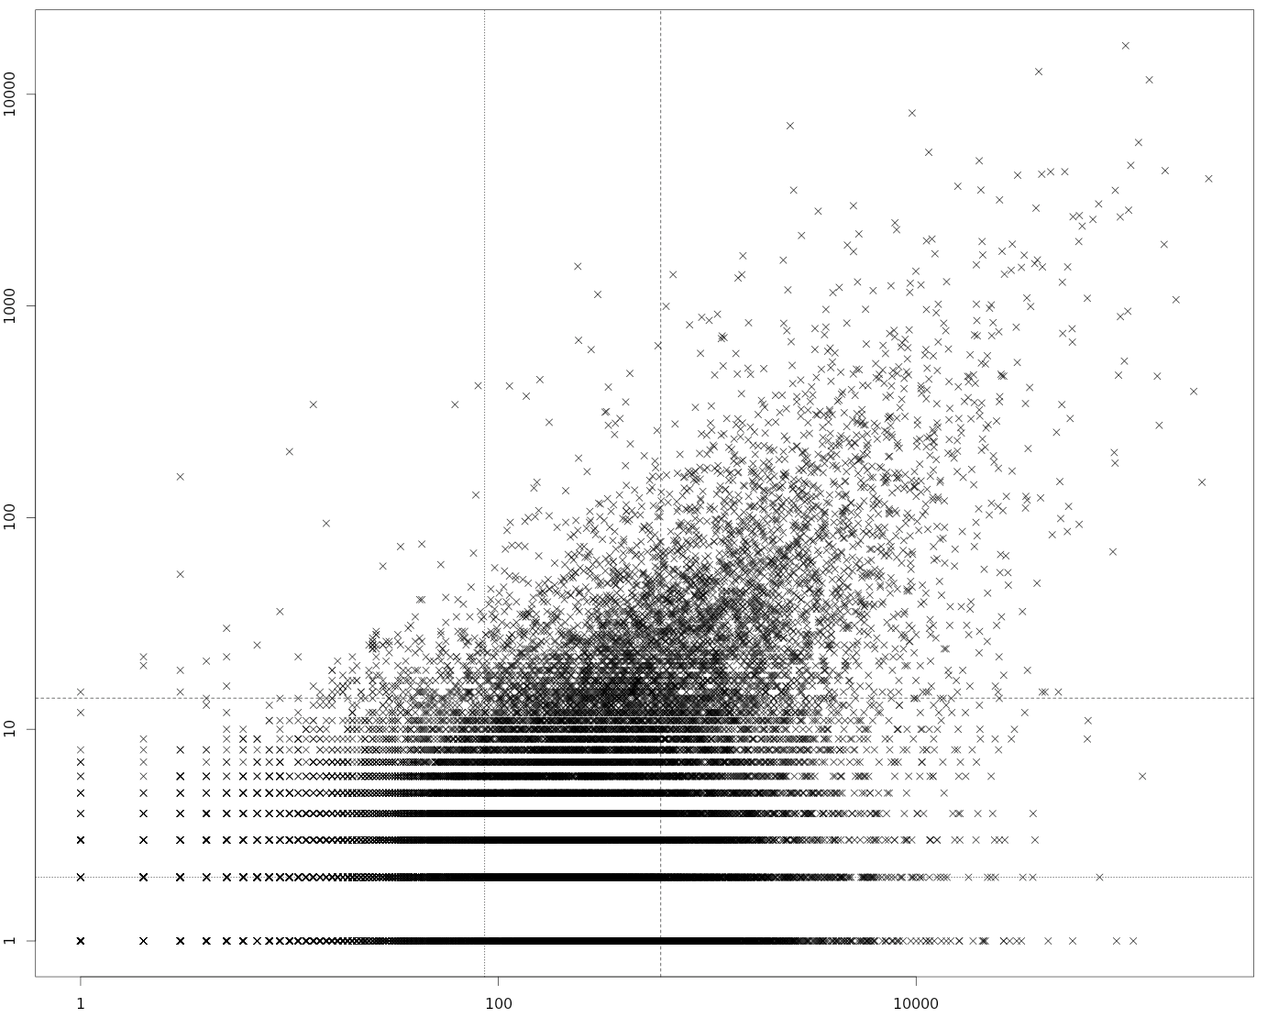
Example: Citizen science
Understand user behavior and engagement
Develop new scientific workflows

Slide 9
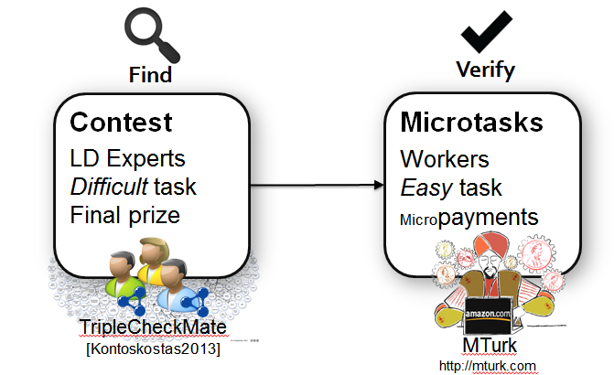
Example: crowdsourced data curation
Find an effective workflow to repair Dbpedia (using several forms of crowdsourcing)

Slide 10
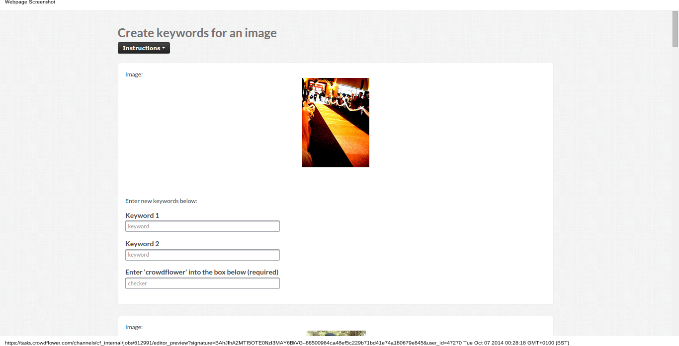
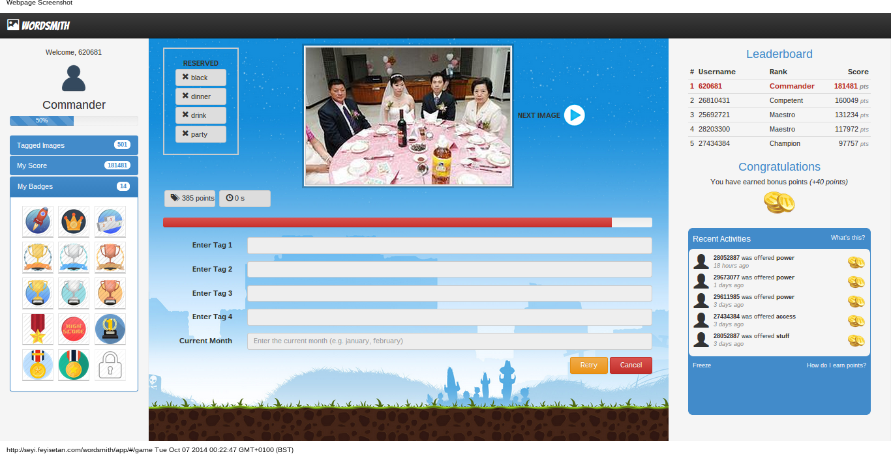
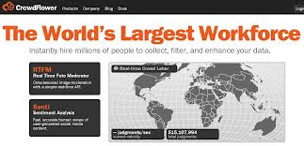
Example: incentives engineering
Make paid crowdsourcing more effective through gamification
Offer a more rewarding/social experience to workers

Slide 11
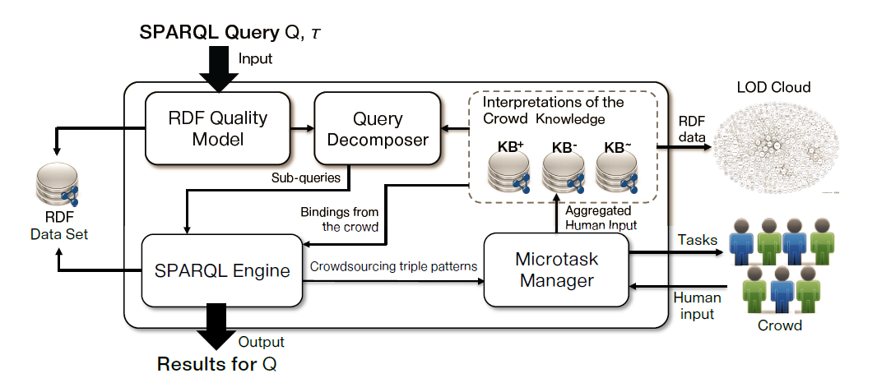
Example: crowd-enabled query processing
Achieve a seamless integration between crowd and automatic query processing capabilities

Slide 12
Summary of research challenges
Design principles and guidelines
Systems combining different paradigms
Integration of human and computational intelligence
Workflow design and support for complex workflows
Quality assurance, speed, task assignment
Data-driven optimizations using log data
  Social network analysis
  User profiling
  Content analysis
Applications to new settings (e.g., enterprise)

Slide 13
Email: e.simperl@soton.ac.uk
Twitter: @esimperl

