Slide 1
Before the Relational Model
COMP3211 Advanced Databases
Dr Nicholas Gibbins – nmg@ecs.soton.ac.uk
2014-2015

Slide 2
The Road Less Travelled

Slide 3
The Road Less Travelled
Lectures so far have concentrated on relational databases
Proposed by Ted Codd in 1969
Developed by IBM for System R in the early 1970s
blahblah SQL blahblah Ingres blahblah Oracle blahblah etc
What came before relational databases?
What can we learn from those systems?

Slide 4
Hierachical Databases

Slide 6
IBM Information Management System
Development started in 1966 to support the Apollo programme
Best known example of a hierarchical database
Still in use!
Fast on common tasks that change infrequently – complements DB2 (IBM’s relational database)
Notes:
Track the bill of materials for the Saturn V and the CSM

Slide 7
Hierarchical Databases
A hierarchy is a natural way to model many real world systems
Taxonomy (“is a kind of”)
Meronymy (“is a part of”)
Many real-world examples
Organisation charts
Library classification systems
Biological taxonomies
Components of manufactures
Hierarchical DBs are built as trees of related record types connected by parent-child relationships

Slide 8
Record Types
Record name
EMPLOYEE
Fields
NAME : CHAR20
NIN : CHAR9
BDATE : DATE
Data type
Notes:
Each node in the tree is a record representing some entity
Records are a collection of field values that provide information about the entity represented by the record
Records of the same type are grouped into record types
Each record type has a name
The structure of a record type is defined by a collection of fields or data items
Each field has a data type (integer, float, string, etc)

Slide 9
Parent-Child Relationship Types
DEPARTMENT
parent
DNAME
MGRNAME
1
N
EMPLOYEE
child
NAME
NIN
BDATE
Notes:
A parent-child relationship type (PCR type) is a 1:N relationship between two record types
The single end is the parent record type
The multiple end has the child record type
(each record may have many children)
Each child may itself have child record types (i.e. it may be the parent in another relationship

Slide 10
Occurrences
An occurrence or instance of the PCR type consists of:
One record of the parent record type
Zero or more records of the child record type
(i.e. an instance is a record and all of its children)
PCR types are referred to by naming the pair of parent record type and child record type
e.g. (DEPARTMENT, EMPLOYEE)

Slide 11
Example Occurrences (DEPARTMENT, EMPLOYEE)
Sales
Smith
Jones
Brown
IT
Fraser
Hardy

Slide 12
Hierarchical Schemas
DEPARTMENT
DNAME
MGRNAME
EMPLOYEE
PROJECT
NAME
NIN
BDATE
PNAME
LOCATION
WORKER
NAME
NIN
HOURS

Slide 13
Hierarchical Occurrence Trees
A database may contain many hierarchical occurrences (occurrence trees)
Occurrence trees correspond to hierarchical schemas
Each occurrence tree is a tree structure whose root is a single record from the root record type of the schema
The occurrence tree contains all the children (and further descendants) of the root record, all the way to records of the leaf record types

Slide 14
Example Occurrence Tree
Sales
Smith
Jones
Brown
Widgets
Doodads
Smith
Jones
Smith
Brown

Slide 15
Issues
Unidirectional relationships do not allow M:N relationships
Multiple parents are not supported – strict hierarchy
Can’t represent an employee that works in more than one department
N-ary relationships (between more than two record types) are not supported
Querying/update requires the programmer to explicitly navigate the hierarchy – poor data independence

Slide 16
Network Databases

Slide 17
Network Databases
Standardised by the Conference on Data Systems Languages (CODASYL) committee in 1969
Addresses limitations of the hierarchical model
Entities may be related to any number of other entities – no longer limited to a tree
CA IDMS possibly the best-known example
Again, many instances still running worldwide
Notes:
Integrated Database Management System

Slide 18
Using Network Databases
Record types linked in 1:N relationships
There are no constraints on the number and direction of links between record types
No need for a root record type

Slide 19
Set Types
DEPARTMENT
Owner type - 1
MAJOR_DEPT
Set type
STUDENT
Member type - n
Notes:
A set type is a description of a 1:N relationship between two record types
Each set type has:
A name
An owner record type (the domain of the relationship)
A member record type (the range of the relationship)

Slide 20
Set Occurrences
Set occurrences (set instances) are composed of:
One owner record from the owner record type
Zero or more related member records from the member record type
A record from the member record type cannot exist in more than one occurrence of a particular set type
Maintains 1:N constraint on set types

Slide 21
Representing M:N Relationships
Set types can only represent 1:N relationships, yet many real-world relationships are M:N
Use a linking or dummy record to join two record types in an M:N relationship
Linking record
D_R
DEPARTMENT
REGISTRATION
S_R
STUDENT

Slide 22
Issues
Quite widely implemented
Easier to model systems with networks than with hierarchies
Can deal with M:N or N-ary relationships
But
Querying/update requires the programmer to explicitly navigate the hierarchy – poor data independence

Slide 23
Why should I care?

Slide 24
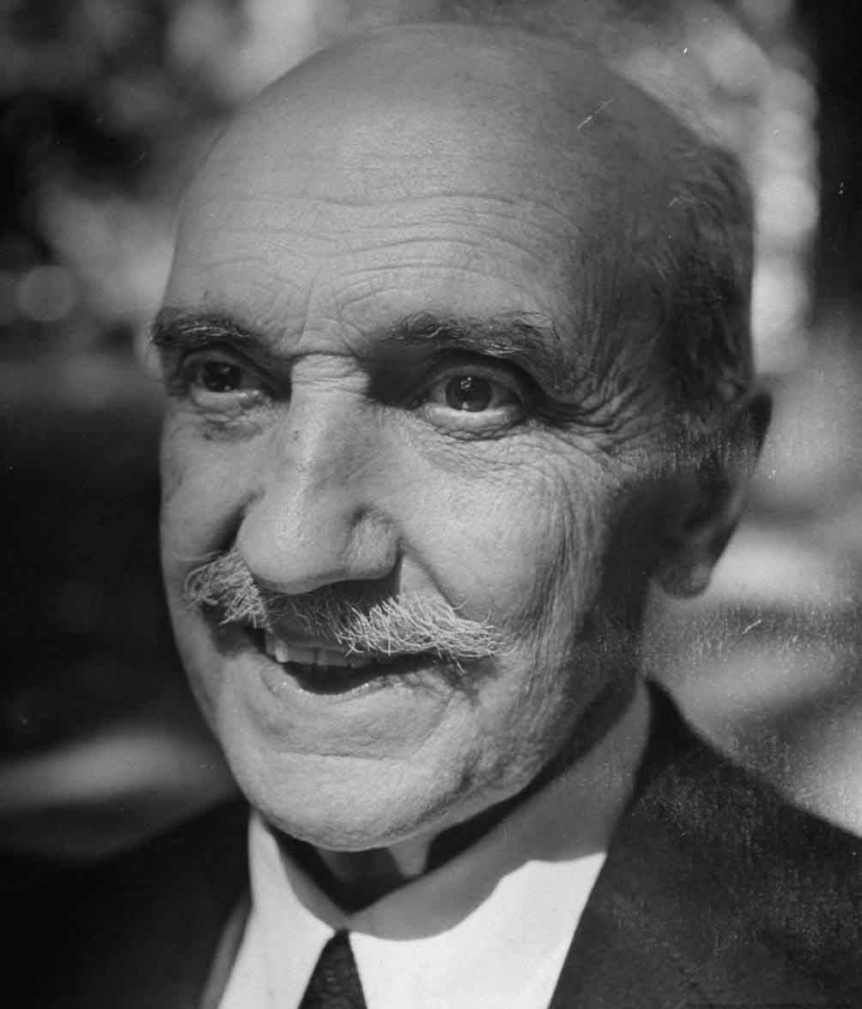
Those who cannot remember the past are condemned to repeat it.

Slide 25
Native XML Databases
Conceptual descendent of hierarchical DBs
Define a logical model for an XML document
Store and retrieve documents according to that model
Elements and attributes
Plain text content (PCDATA)
Ordering of elements (document order)
Common models
XPath data model
XML Infoset
XML Document Object Model (DOM)

Slide 26
XML in a Nutshell
<foo>Some text</foo> | The foo element
<foo>Some text</foo> | The contents of the foo element (plain text)
<bar/> | An empty element, bar
<foo><bar/></foo> | The contents of the foo element (an element)
<foo baz="qux"> | The baz attribute on the foo element
<foo baz="qux"> | The value of the baz attribute

Slide 27
Example XML Database
<company> <department dname="Sales" mgrname="Smith, J"> <employee name="Smith, J" birthdate="1969-05-23"/> <employee name="Jones, P" birthdate="1961-02-22"/> <employee name="Brown, M" birthdate="1973-06-14"/> <project pname="Widgets" status="current" location="Manchester"> <worker name="Smith, J" hours="20"/> <worker name="Jones, P" hours="40"/> </project> <project pname="Doodads" status="expired" location="London"> <worker name="Smith, J" hours="20"/> <worker name="Brown, M" hours="40"/> </project> </department> </company>

Slide 28
XQuery example
<dl> { for $w in document("company.xml")//project[@status="current"]/worker where $w/@hours>20 return <dt>$w/@name</dt><dd>$w/@hours</dd> } </dl>
=>
<dl> <dt>Smith, J</dt><dd>20</dd> <dt>Jones, P</dt><dd>40</dd> </dl>

Slide 29
NoSQL...

