Slide 1
UbiCamp Videos
Lifelong Learning Programme
Erasmus Multilateral Projects
UbiCamp: Integrated Solution to Virtual Mobility Barriers
Project ID: 526843-LLP-1-2012-ES-ERASMUS-ESMO
Notes:
Slides based on the following information
Folks
Congratulations on reaching the end of your first year of studies at the University of Southampton. I know many of you are ambitious and always looking for new opportunities, so I wonder if any of you are interested in some additional, remote study, during your second year?
I am involved in a research project which is looking at virtual mobility (http://www.ubicamp.eu/inicio ). As you know travel abroad and study abroad can be expensive, this is an opportunity to take some additional studies, in English , taught remotely. In many ways, this programme is related to the approaches to study we are hoping you would develop in COMP1205 and some of you may well be interested in following up this opportunity. A list of things you might study is below, details at http://www.ubicamp.eu/courses If you are interested in any way please get back to me right now :-)
Kaunas University of Technology
Project Management
Management
Autonomous University of Madrid
Introduction to Programming in C and Linux Operating System
Introduction to Videogames programming
Multimedia Educational Resources
University of Oviedo
Corporate Social Responsibility
Introduction to Economics
Innovation and Project in primary education
Software Architecture
Vytauto Didžiojo Universitetas
Open Educational Resources
Digital graphics programming
Information Technologies in Education
Collaborative learning
Yasar Üniversitesi
EU Education Programmes and Project Management
EU-Turkey Relations
Università Telematica Pegaso
lnternational Business Communication
And whatever you are doing, I hope you have a very enjoyable and productive vacation and look forward to seeing you in the autumn term next year.
Kind regards Su

Slide 2
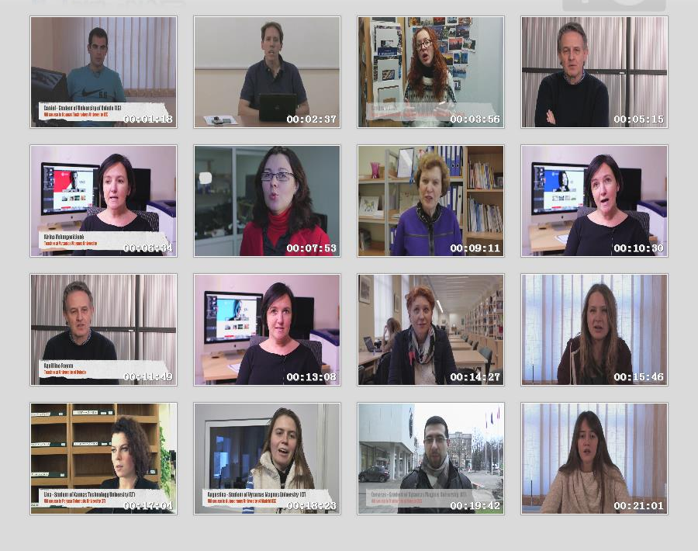
00 Best practice video stories
URL: https://www.youtube.com/watch?v=bW_Z2qGmOMs
Content: Includes all the rest nine videos.

Slide 3
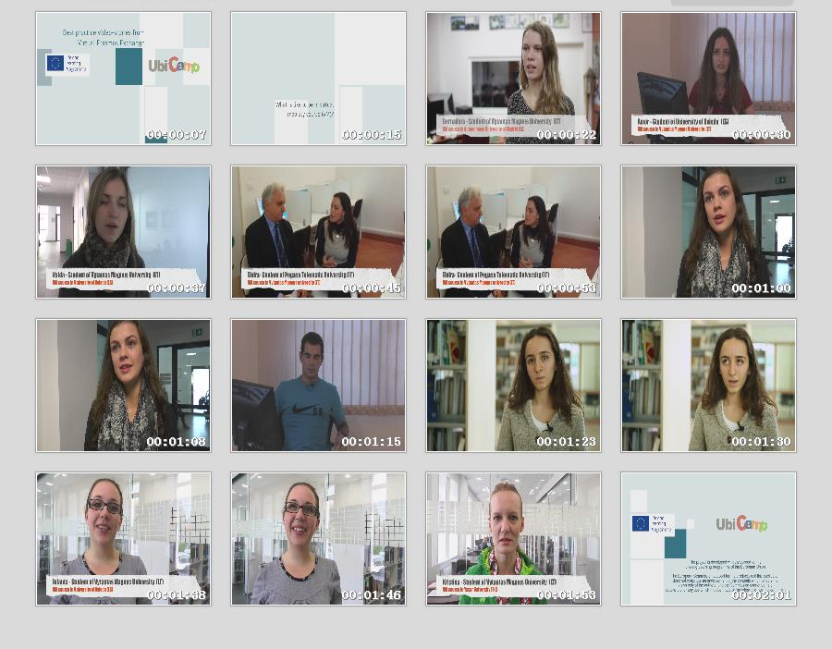
01 What is like
URL: https://www.youtube.com/watch?v=cGZvI1p4afY
Content: What is like to be in virtual mobility course (VM)?

Slide 4
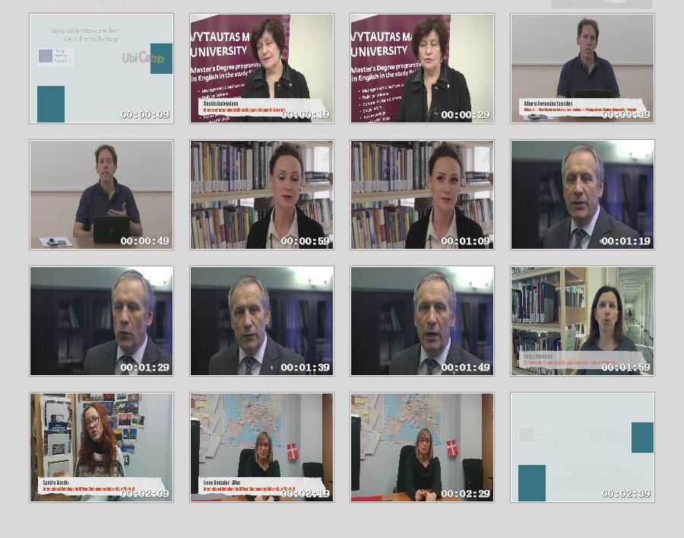
02 Future of education
URL: https://www.youtube.com/watch?v=pBV8LLaZiCg
Content: The future of education

Slide 5
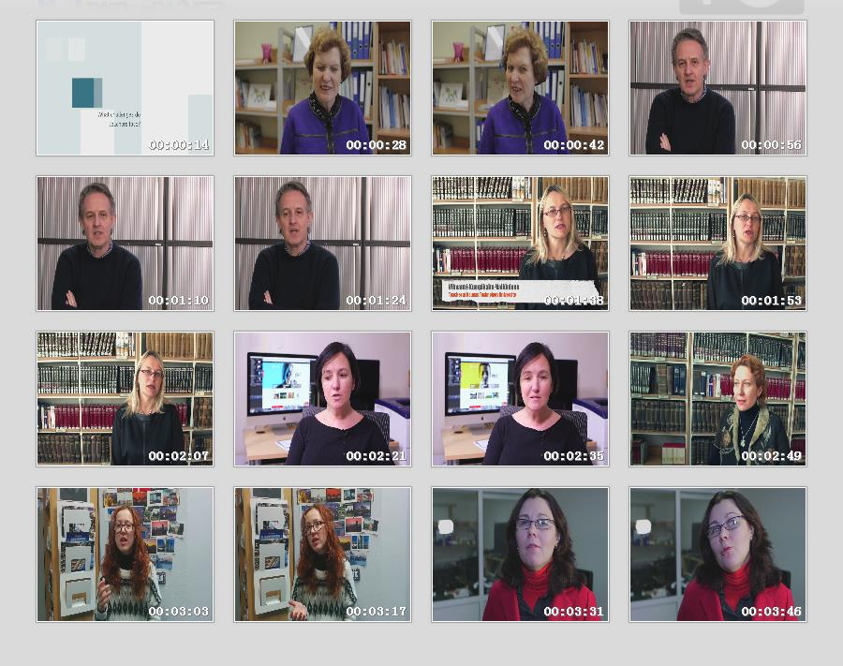
03 Challenges for teachers
URL: https://www.youtube.com/watch?v=hrQk7NREeE8
Content: What challenges do teachers face?

Slide 6
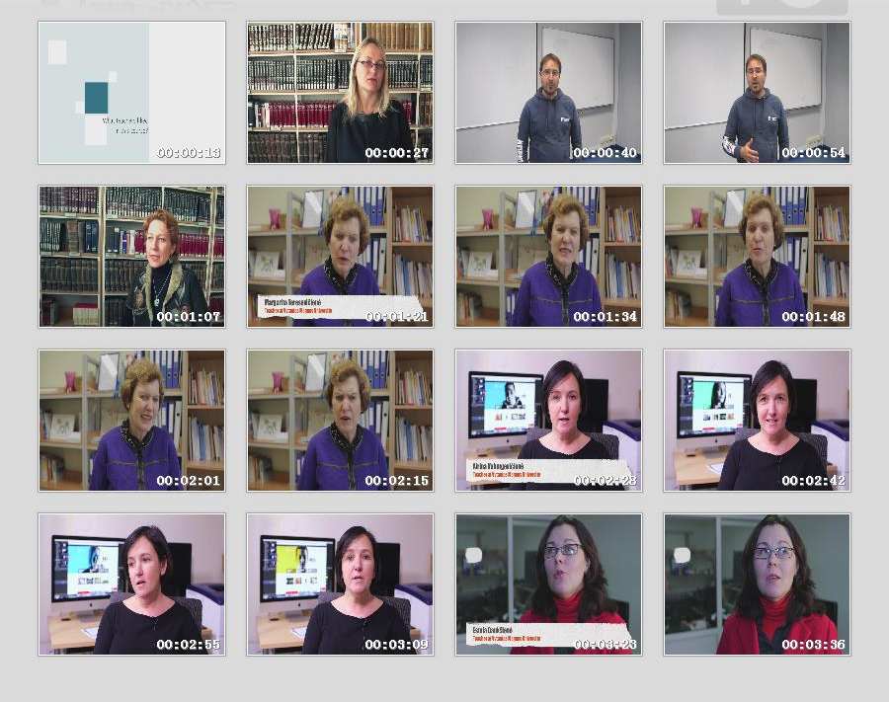
04 What teachers liked
URL: https://www.youtube.com/watch?v=jzzvLQaCLzA
Content: What teachers liked in this course?

Slide 7
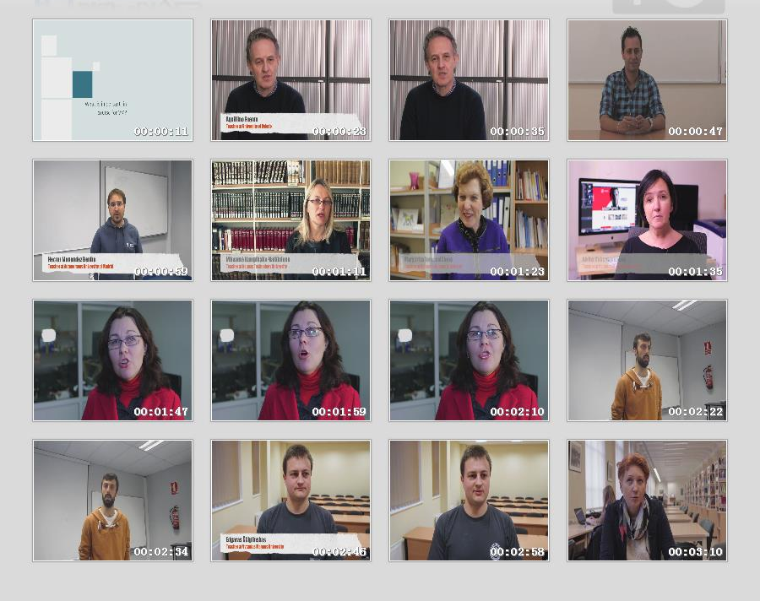
05 What is important in VM
URL: https://www.youtube.com/watch?v=bgDoOvfXj7I
Content: What is important in course for VM?

Slide 8
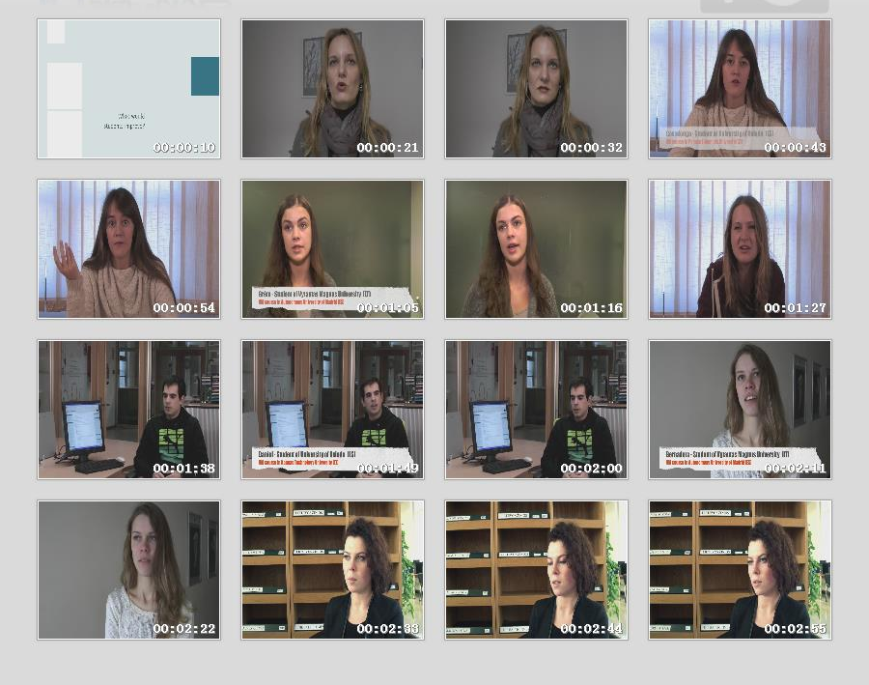
06 What would students improve
URL: https://www.youtube.com/watch?v=rlzDsFFrgE8
Content: What would students improve?

Slide 9
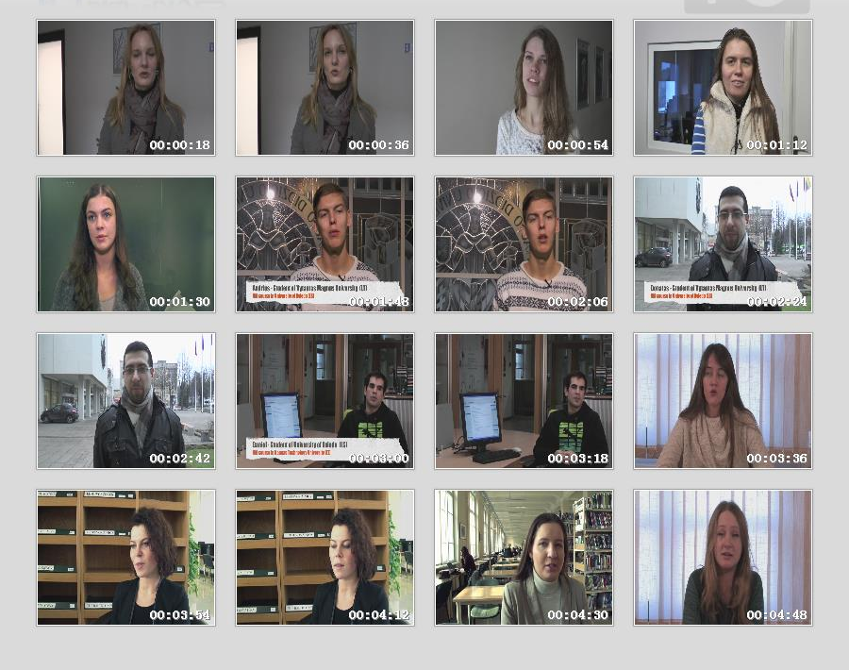
07 Would you recommend this course to friend
URL: https://www.youtube.com/watch?v=Xvvqf6bP6BU
Content: Would you recommend this VM course to your friend?

Slide 10
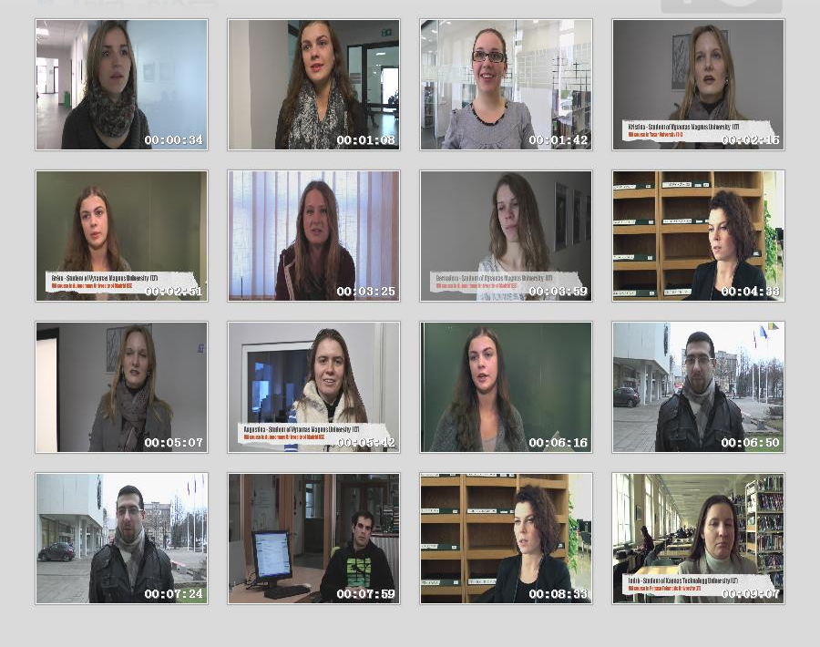
08 Students about VM
URL: https://www.youtube.com/watch?v=ms9eAaLtkAM
Content: Students about virtual mobility (VM)

Slide 11
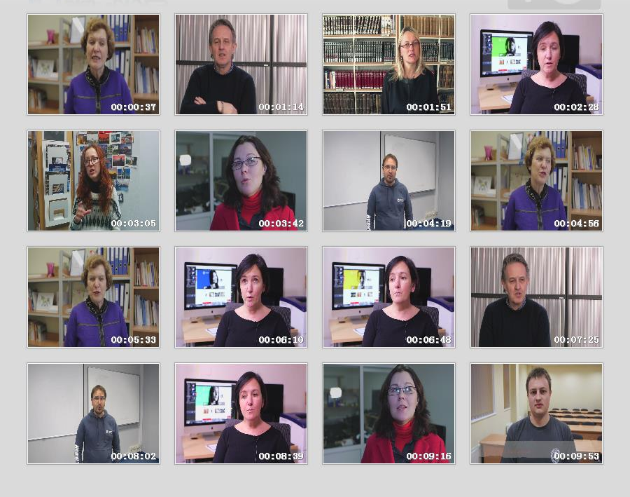
09 Teachers about VM
URL: https://www.youtube.com/watch?v=sXrspaQg5pE
Content: What challenges do teachers face? What is important in course for VM?

