Slide 1
Data Types
COMP3211 Advanced Databases
Dr Nicholas Gibbins - nmg@ecs.soton.ac.uk
2016-2017

Slide 2
Overview
Data types and operations
Temporal data
Spatial data
Multimedia data

Slide 3
Data Types and Operations

Slide 4
Data Types
Numeric
Character
Temporal
Spatial
Image
Text
Audio and Video

Slide 5
Operations on Data
Comparison
Arithmetic
Fuzzy searches
Retrieve all documents that contain a given word
Find a picture that contains blue sky

Slide 6
Which operations are meaningful?
Can you add two weights together?
2kg + 2kg = ?
Can you multiply two weights?
2kg * 2kg = ?
Can you add a weight to a quantity?
13 + 2kg = ?
Can you multiply a weight by a quantity?
13 * 2 kg = ?

Slide 7
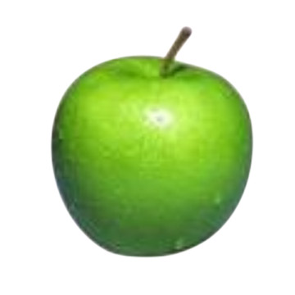
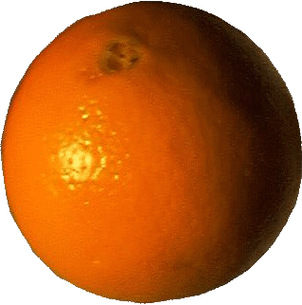
Which operations are meaningful?
Can you compare two images?
=

Slide 8
Which operations are meaningful?
Can you add two images?
+
= ?

Slide 9
Further Questions
Is the data ordered in any sense?
Total order vs. partial order
Does the order actually have any meaning, or is it just a convenience?
Notes:
total – integers
partial – sets and subsets

Slide 10
Temporal Data

Slide 11
Temporal Data
The dimension of time is needed to answer such questions as:
What was the average price of product X during 1995?
In which month did we sell the most copies of video Y?
What was the treatment history for patient Z?

Slide 12
Characteristics of Time
Time structure
Linear
Possible futures
Branching time
Directed acyclic graph
Periodic/cyclic
Boundedness of time
Unbounded
Time origin exists
Bounded at both ends

Slide 13
Time Density: Discrete
Timeline is isomorphic to the integers
Integers have a total order
Timeline is composed of fixed periods, termed chronons
Between each pair of chronons is a finite number of other chronons

Slide 14
Time Density: Dense
Timeline is isomorphic to the rational numbers
Rational numbers have a partial order
Between each pair of chronons is an infinite number of other chronons

Slide 15
Time Density: Continuous
Timeline is isomorphic to the real numbers
Real numbers have a total order
Between each pair of chronons is an infinite number of other chronons

Slide 16
Characteristics of Time
Granularity if important
Event A occurs at 11.00am
Event B occurs at 3.00pm the same day
Does event A precede event B?
The answer is different if
Granularity is one day
Granularity is one minute
There is also a distinction between sequence and time

Slide 17
Storing Times in a Database
Various times may be associated with an event that appears in a database
We may wish to record
The Valid Time of a fact – when the fact is true in reality
The Transaction Time of a fact – when the fact is current in the database, and can be retrieved
Both of these (bitemporal)

Slide 18
SQL Extensions
TSQL includes:
A WHEN clause (see next slide)
Retrieval of timestamps
Retrieval of temporally ordered information
Using the TIME-SLICE clause to specify a time domain
Using the GROUP BY clause for modified aggregate functions

Slide 19
TSQL WHEN Clause
Format of the SELECT … WHEN statement
SELECT { select-list } FROM { list of relations } WHERE { where-clause } WHEN { temporal clause }
Temporal comparison operators include:
BEFORE/AFTER, FOLLOWS/PRECEDES DURING, EQUIVALENT, ADJACENT, OVERLAPS
(compare with Allen’s Interval Calculus)

Slide 20
Spatial Data

Slide 21
Spatial Data
Data Types include:
Points
Regions
Boxes
Quadrangles
Polynomial surfaces
Vectors

Slide 22
Spatial Data
Operations include:
Length
Intersect
Contains
Overlaps
Centre

Slide 23
Spatial Data Applications
Computer Aided Design (CAD)
Computer generated graphics
Geographic Information Systems (GIS
For these systems, the properties of interest would include:
Connectivity
Adjacency
Order
Metric relations

Slide 24
Spatial Data Characteristics
In systems dealing with space:
Data objects may be highly complex
Data volumes may be very large
Data may be held in real time
Performance is not easy to achieve
Access is likely to be through specialised graphical front ends; operator skills are key
Query processing will not be performed using SQL

Slide 25
Multimedia Data

Slide 26
Textual Data
Text data may be
Already in machine-readable form, from a word-processor, spreadsheet or other source
Read using OCR techniques
Text data is essentially unstructured, and an index of some kind needs to be built
By a human operator
Automatically by building a inverted list of every significant word in the database

Slide 27
Textual Data
Markup languages do give some structure to a document
HTML is a markup language for the Web
XML (and its predecessor SGML) allows a programmer to create portable documents that contain structured data
Can also create new markup languages
Character Large Objects (CLOBs) are now commonly supported by vendors
Able to store and handle text documents in addition to standard data
Provision of text search and retrieval facilities

Slide 28
Text and Documents
Much data is stored in the form of text
It would be very useful to be able to ask queries such as:
Find all the legal documents concerning client ‘Jones’
Find all the suspects with false teeth who have been interviewed
Find all the articles on ‘databases’

Slide 29
Image Data
Examples of still images include:
X-Rays
Maps
Photographs
These are all classified as binary large objects (BLOBs)
A BLOB has no semantics attached

Slide 30
Image Databases
An image database needs to provide support for
Image analysis and pattern recognition
Image structuring and understanding
Spatial reasoning and image information retrieval
Mainstream DB vendors now adding
Support for BLOBs
Access using QBIC (Query by Image Content)

Slide 31
Audio Data
Digitised sound
Stored in various formats, such as WAV or MP3
Consumes large amounts of storage
Compression techniques normally used
MIDI (Musical Instrument Digital Interface)
More compact than digitised audio
Consists of a sequence of instructions: Note_On, Note_Off, Increase_Volume
Interpreted by a synthesiser

Slide 32
Video Data
One of the most space hungry formats of all
Images stored as a sequence of frames
Each frame can consume over a megabyte
Frames typically played back at 24-30 fps
To integrate video and audio, interleaved file structures incorporate times sequencing of audio/video playback
Microsoft AVI
Apple Quicktime

