Slide 1
The Architecture of the World Wide Web
COMP3220 Web Infrastructure
COMP6218 Web Architecture
Dr Nicholas Gibbins – nmg@ecs.soton.ac.uk
2017-2018

Slide 2

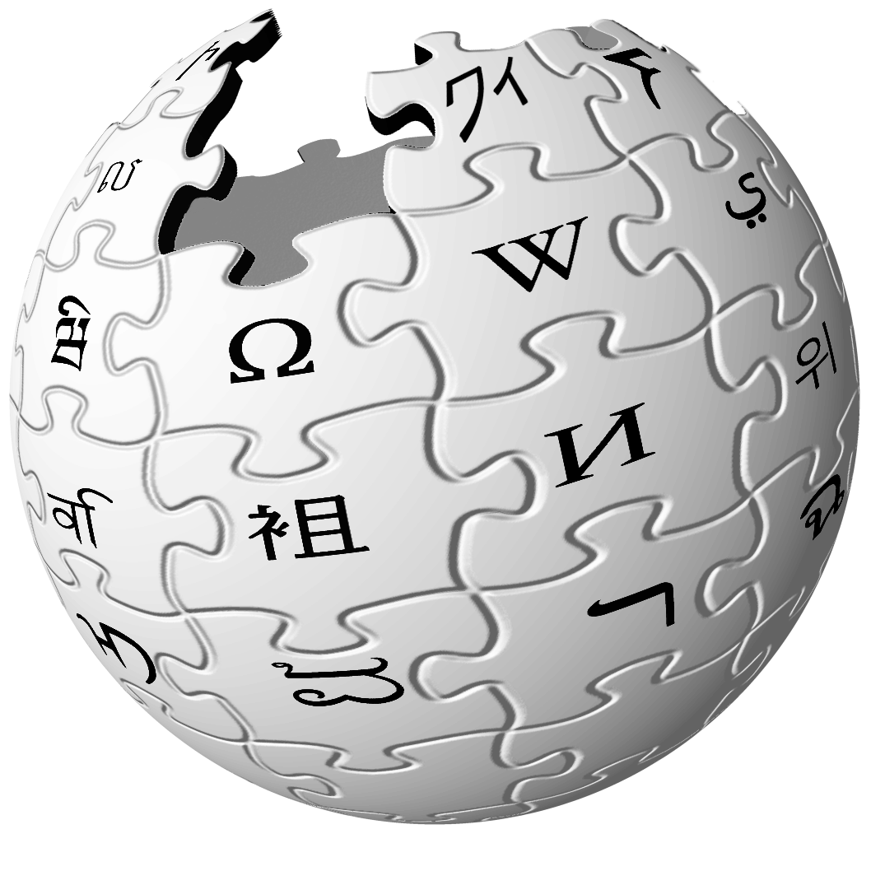






What is the Web?
The Web is a distributed information system that provides access to hypertext documents and other objects of interest
We have a general name for these objects of interest:
resources

Slide 3
A definition (from RFC3986)
“Familiar examples [of resources] include an electronic document, an image, a source of information with a consistent purpose (e.g., ‘today's weather report for Los Angeles’), a service (e.g., an HTTP-to-SMS gateway), and a collection of other resources. A resource is not necessarily accessible via the Internet; e.g., human beings, corporations, and bound books in a library can also be resources. Likewise, abstract concepts can be resources, such as the operators and operands of a mathematical equation, the types of a relationship (e.g., ‘parent’ or ‘employee’), or numeric values (e.g., zero, one, and infinity).”

Slide 4
Example
Resource
today’s BBC weather forecast for Southampton

Slide 5
Architectural Bases of the Web
The notion of a resource is central to the architecture of the Web
We need to be able to:
  identify them
  represent them
  interact with them

Slide 6
Identification

Slide 7
Identifiers should be global
Global naming leads to global network effects.

Slide 8
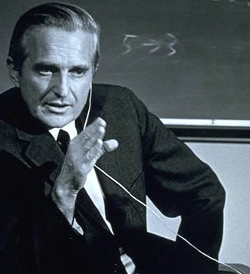
Every object should be addressable
In principle, every object that someone might validly want/need to cite should have an unambiguous address (capable of being portrayed in a manner as to be human readable and interpretable). (e.g., not acceptable to be unable to link to an object within a ‘frame’ or ‘card.’)
Englebart, D.C. (1990) Knowledge-Domain Interoperability and an Open Hyperdocument
System. Proceedings of the Conference on Computer-Supported Collaborative Work.

Slide 9
Uniform Resource Identifiers
A “compact string of characters for identifying an abstract or physical resource”
General syntax:
<scheme>:<hierarchical part>?<query>#<fragment>

Slide 10
Example
URI
identifies
http://www.bbc.co.uk/weather/2637487
Resource
today’s BBC weather forecast for Southampton

Slide 11
URI Schemes and Examples
http://www.example.org/aboutus#staff
https://www.example.org/login
mailto:joe@example.org
ftp://example.org/aDirectory/aFile
news:comp.infosystems.www
tel:+1-816-555-1212
ldap://ldap.example.org/c=GB?objectClass?one
urn:oasis:names:tc:entity:xmlns:xml:catalog

Slide 12
Assign distinct URIs to distinct resources
Using the same URI to directly identify different resources produces a URI collision. Collision often imposes a cost in communication due to the effort required to resolve ambiguities.

Slide 13
Avoid URI aliases
A URI owner SHOULD NOT associate arbitrarily different URIs with the same resource.
  The value of a given resource can be measured by the number and value of the resources that link to it.

Slide 14
The Early Web
Early (pre-1991) documents refer to document naming
  “As many protocols are currently used for information retrieval, the address must be capable of encompassing many protocols, access methods or, indeed, naming schemes”
  “A hypertext link to a document ought to be specified using the most logical name as opposed to a physical address. This is (almost) the only way of getting over the problem of documents being physically moved. As the naming scheme becomes more abstract, resolving the name becomes less of a simple look-up and more of a search.”
http://www.w3.org/DesignIssues/Naming
Notes:
naming and addressing treated as near-synonyms

Slide 15
The Classical View
Early to mid-90s web specs distinguished between:
Resource locations (URLs)
  Often associated with network protocols (http, ftp, telnet)
Resource names (URNs)
  Independent of location (e.g. isbn)
Resource identifiers (URIs)
  Union of the above, possibly also including other classes (URCs, etc)

Slide 16
The Classical View
URIs
URLs
URNs

Slide 17
The Classical View
URL resolution is (usually) well-defined
URNs don’t necessarily have well-defined resolution semantics
  Resolving names depends on context
  What does resolution mean for URIs which do not refer to network resources?

Slide 18
The Modern View
Formal URL/URN distinction is unhelpful
URL is a useful informal concept
  “a URL is a type of URI that identifies a resource via a representation of its primary access mechanism”
http://www.w3.org/TR/uri-clarification/

Slide 19
Representation

Slide 20
Defining Representation
A representation is data that encodes information about resource state. Representations do not necessarily describe the resource, or portray a likeness of the resource, or represent the resource in other senses of the word "represent".
Representations of a resource may be sent or received using interaction protocols.
Notes:
resource – an interview
representations – a text transcript, an audio recording, a video recording

Slide 21
Example
Resource
today’s BBC weather forecast for Southampton
Representation
represents
Metadata:
Content-Type: text/html
Data:
<html>
<head>
<title>BBC Weather – Southampton</title>
...
</html>

Slide 22
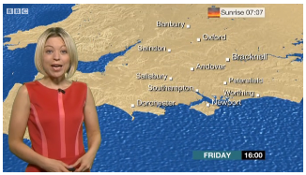
Example
Representation
Metadata:
Content-Type: video/mp4
Data:
represents
Resource
today’s BBC weather forecast for Southampton
Representation
represents
Metadata:
Content-Type: text/html
Data:
<html>
<head>
<title>BBC Weather – Southampton</title>
...
</html>

Slide 23
Internet Media Types
Hierarchical descriptions of data types used (originally) in email (MIME)
Top-level types: text, image, audio, video, application
(also multipart and message)
Refinements of these top-level types:
  text/plain, text/html, text/xml, text/csv, …
  image/jpeg, image/gif, image/png, image/tiff, …
  audio/mpeg, audio/ogg, …
  video/mp4, video/quicktime, …
  application/ecmascript, application/pdf, application/rdf+xml, …
Notes:
encoding may be in a number of formats – need to identify formats

Slide 24
Separation of content, presentation and interaction
A specification SHOULD allow authors to separate content from both presentation and interaction concerns.

Slide 25
Link identification
A specification SHOULD provide ways to identify links to other resources, including to secondary resources (via fragment identifiers).
Notes:
Forward reference to REST

Slide 26
Web linking
A specification SHOULD allow Web-wide linking, not just internal document linking.
Notes:
Forward reference to REST

Slide 27
Generic URIs
A specification SHOULD allow content authors to use URIs without constraining them to a limited set of URI schemes.

Slide 28
Hypertext links
A data format SHOULD incorporate hypertext links if hypertext is the expected user interface paradigm.
Notes:
Forward reference to REST

Slide 29
Interaction

Slide 30
Interaction
The interactions between Web agents and resources are defined in terms of protocols that control the exchange of messages
  HTTP, FTP, SOAP, NNTP, SMTP, ...
Messages include both data and metadata

Slide 31
Dereferencing URIs
The schemes in URIs used to identify resources may indicate protocols that can be used to access those resources
  Though not always: caches, proxies, name resolution services
  Many URI schemes define a default interaction protocol
Resource access takes several forms:
  Retrieving a representation of the resource
  Adding or modifying a representation of the resource
  Deleting some or all representations of the resource

Slide 32
Example
URI
identifies
http://www.bbc.co.uk/weather/2637487
Resource
yields on dereference
today’s BBC weather forecast for Southampton
Representation
represents
Metadata:
Content-Type: text/html
Data:
<html>
<head>
<title>BBC Weather – Southampton</title>
...
</html>

Slide 33
Reuse representation formats
New protocols created for the Web SHOULD transmit representations as octet streams typed by Internet media types.

Slide 34
Safe retrieval
Agents do not incur obligations by retrieving a representation.

Slide 35
Available representation
A URI owner SHOULD provide representations of the resource it identifies.

Slide 36
Reference does not imply dereference
An application developer or specification author SHOULD NOT require networked retrieval of representations each time they are referenced.

Slide 37
Consistent representation
A URI owner SHOULD provide representations of the identified resource consistently and predictably.

Slide 38
Conclusion
URI
identifies
http://www.bbc.co.uk/weather/2637487
Resource
yields on dereference
today’s BBC weather forecast for Southampton
Representation
represents
Metadata:
Content-Type: text/html
Data:
<html>
<head>
<title>BBC Weather – Southampton</title>
...
</html>

Slide 39
Summary
The Web Architecture has three parts:
  Identification (URIs)
  Representation (formats: HTML, XML, PNG, etc)
  Interaction (protocols: HTTP)

Slide 40
Further Reading
Architecture of the World Wide Web, Volume One
  http://www.w3.org/TR/webarch/
Architectural Styles and the Design of Network-based Software Architectures, Chapter 4
  http://www.ics.uci.edu/~fielding/pubs/dissertation/top.htm

Slide 41
Next Lecture:
HTTP

